Slide 1
Poor Change Mgmt Consequences
Reduced productivity
Resist passively
Resist actively
Employee turnover
Apathy toward the environment
Disagreements about moving forward
Increased absenteeism
Lack of support for changes
Short-cutting the system
Old habits resurface
Change effort is abandoned
“Tribes” form

Slide 2
Change Management Involves 5 Things
Change management focuses on the ‘people side’ of organizational change
Change management involves both an individual and an organizational perspective
Change management requires action and involvement by leaders and managers throughout the organization
Change management and project management are both tools that support project benefit realization – project management is the ‘technical’ side and change management is the ‘people’ side
Change management is most effective when it is launched at the beginning of a project and integrated into the project activities
(c) Prosci 2013 change-management.com Used with permission

Slide 3
What is a business coach?
Helps you look at the big picture
Guides you in enhancing your business skills
Provides candid feedback
Helps you identify business opportunities
Links you with other professionals
Helps you through business transitions
Listens to the problems you are facing
Helps you set goals
Encourages and motivates you

Slide 4
States of Change
Existing
state
Change
state
Vision
state
The way things are currently done
How things will be done while we transform
The ideal state of doing things

Slide 5
Prosci® PCTTM Model
Leadership / Sponsorship provides guidance and governance
Project Management gives structure to the technical side of the change
Change Management supports the people side of the change
Leadership/ sponsorship
Meet objectives
On time and budget
ROI
Project management
Change management
All three elements must be present for project success

Slide 6
How Do I Document Success?
Document the goal
Record goal progress at regular intervals
Note progress on learning objectives
Impact on personal effectiveness
Business impact
Practical use of what was learned
Publicity and recognition

Slide 7
Successful root cause analysis needs…
Stakeholders sold on solving the problem and champions for change
Subject matter experts with domain expertise
Trained facilitator for RCA meetings
Dedicated time (2-10 days) to focus on the problem
Commitment and effort devoted to doing the work
The right tools and processes to get the work done right

Slide 8
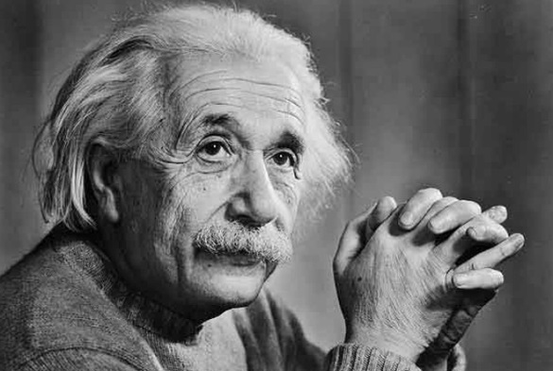
There are 8 personality types
Analysts
Architect
Commander
Logician
Debater
Explorers
Virtuoso
Adventurer
Entrepreneur
Entertainer
Notes:
At the Life Cycle Institute class leaders are called facilitators. This acknowledges that in addition to being experienced authorities on their topic, they have a passion for teaching and have developed this passion into a set of learning facilitation skills.
An instructor is a content resource. Most content experts share their knowledge through writing or lectures. When they instruct, they appear as the “sage on the stage” imparting all knowledge to a passive participant. They are a content resource. They control what is taught and when. It is up to the participant to adapt their personal style and prior knowledge to learn new skills and knowledge.
A facilitator is a process manager first, a content resource second. Facilitators use their knowledge of how people learn to create an active environment that embraces participants’ prior knowledge and unique learning style. They engage the participant in taking charge of their learning. When they facilitate, they appear as a “guide by the side” encouraging the sharing of knowledge by and with an active participant.
Our facilitators practice what they teach and teach what they practice.
Typically facilitators have anywhere from 10-25+years of practical experience applying what they are teaching (average is 25!).
They spend 70% of their time applying what they are teaching in coaching and consulting with a wide variety of clients.
Facilitators are industry published experts in their field. Over a dozen books published by LCE facilitator authors.
Facilitators are active members in SMRP, IEE, ASME, and other professional organizations. Facilitators include 8 certified CMRPs, CPMM, CRE and certified Professional Engineers.
Experienced learning facilitators are selected through a rigorous qualification process. This process is designed to select people who are truly talented at facilitating teaching. In addition to content expertise each facilitator is trained on adult learning theory and methods.

Slide 9
Condensation
The Water Cycle
Condensation is a crucial component of distillation
Because condensation is a naturally occurring phenomenon, it can often be used to generate water in large quantities for human use.
Such systems can often be used to retain soil moisture in areas with active deforestation
Condensation is a critical step in many industrial processes, such as power generation, water desalination, thermal management, refrigeration, and air conditioning
Condensation
Precipitation
Evaporation
Drainage

